Slide 1
XYZ ADS AIRING REPORT
Ayush Saxena

Slide 2
Outline
1. Project Description
2. Approach
We have provided the dataset having different TV Airing Brands, their product, and their category. The dataset includes the network through which Ads are airing, types of networks like Cable/ Broadcast, and the show name on which Ads aired. You can also see the data of Dayparts, Time zone, and the time & date at which Ads got aired. It also includes other data like Pod Position (the lesser the valuable), the duration for which Ads aired on screen, Equivalent sales, and the total amount spent on the Ads aired.
For completing this analysis, we have first gone through the dataset and then we have cleaned the data we removed the outliers and noise from the data as the data is too big and it takes too much time in excel to clean the data, but we have taken this part as a challenge and cleaned it and then we have successfully completed all the question as asked by the team. After completing the project, we made the PowerPoint slides so that team can understand the project easily.
3. Tech-Stack
4. AGENDA
5. AGENDA
As to complete this project we have used Excel to extract meaningful insights and Microsoft PowerPoint for presentation
In Excel sheets, we have performed different types of analysis.
Applied different formulas and functions.
We used Pivot Tables and inserted the Charts for Visualizations.
What is Pod Position? Does the Pod position number affect the amount a company spends on Ads for a specific period?
What is the share of various brands in TV airings and how has it changed from Q1 to Q4 in 2021?
Conduct a competitive analysis for the brands and define the advertisement strategy of different brands and how it differs across the brands.
Mahindra and Mahindra want to run a digital ad campaign to complement its existing TV ads in Q1 of 2022. Based on the data from 2021, suggest a media plan to the CMO of Mahindra and Mahindra. Which audience should they target? Assume XYZ Ads has the ad viewership data and TV viewership for the people in India. P.S. Brownie points for any additional actionable insights you can draw from the dataset.

Slide 3

Introduction
A television advertisement (also called a television commercial, TV commercial, commercial, spot, television spot, TV spot, advertisement, television advertisement, TV advertisement, television ad, TV ad, or simply an ad) is a span of television programming produced and paid for by an organization. It conveys a message promoting, and aiming to market, a product, service, or idea. Advertisers or marketers may refer to television commercials as TVCs. Advertising revenue provides a significant portion of the funding for most privately owned television networks. During the 2010s, the number of commercials has grown steadily, though the length of each commercial has diminished. Advertisements of this type have promoted a wide variety of goods, services, and ideas ever since the early days of the history of television

Slide 4
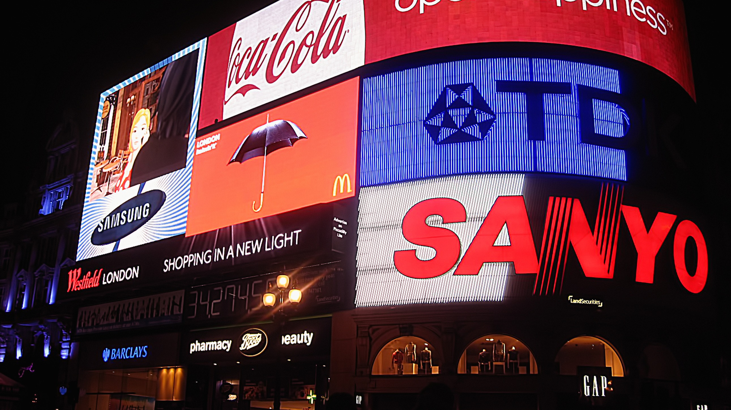
Advertisement Pods Industry

Slide 5
What is Pod Position? Does the Pod position number affect the amount a company spends on Ads for a specific period? (Explain in Detail with examples from the dataset provided).
An ad pod is a loop of ads that are sequenced together to be played back-to-back within a single ad break/placement, like ad breaks in traditional linear TV. It helps the publishers to get the opportunity to maximize revenue from each ad break and gives advertisers more control over ad positioning. They allow publishers to return multiple ads from a single ad request, and then those ads are played in sequence
There are several reasons why advertisers and publishers use ad pods:-
They offer more control Ad pods help advertisers avoid running ads alongside direct competitors, ensuring that their offering stands out to viewers and that their message doesn’t get saturated.
After Analyzing the different POD positions,
I can conclude that Yes POD Position affects the amount of spending on Ads for a specific time.
Among all time frames companies prefer Primetime to play ads In that also they prefer POD Position 1. and after that it will play in a loop as shown in next slides.
After POD 1 instead of 2nd companies prefer POD 3rd .
In the next slides we will see the graphs of the first 3rd POD positions.

Slide 6
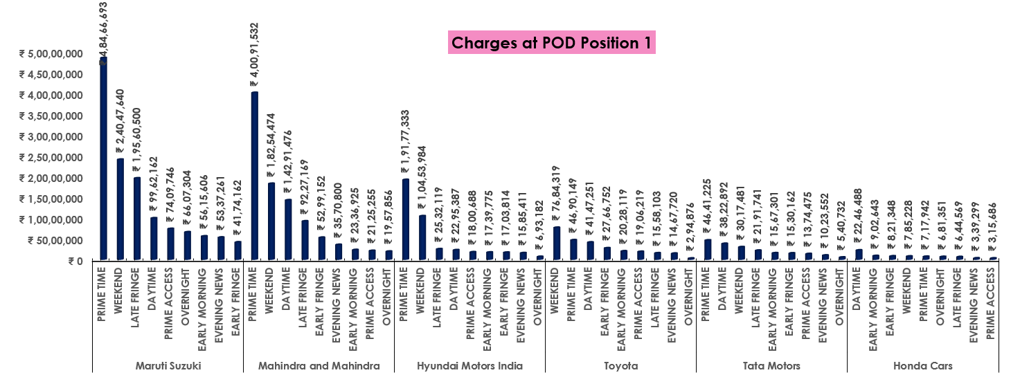
Analysis of POD Position 1
For POD Position One, companies are charging nearly 4.8 Cr for Primetime which is highest over other time zones
It means companies favor Prime time to play their ads, then after the weekend and Late fringe.

Slide 7
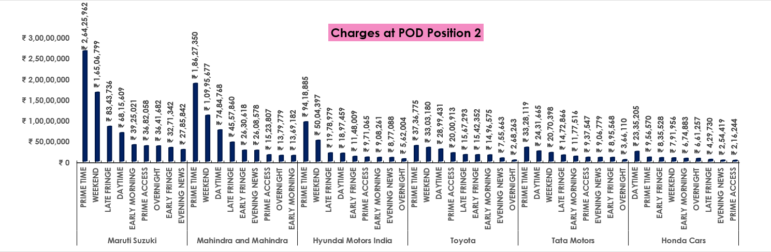
Analysis of POD Position 2
For POD Position Two, companies are charging nearly 50% less than Primetime of POD One.
In this chart also companies are charging more for prime time respective to other time zones.

Slide 8
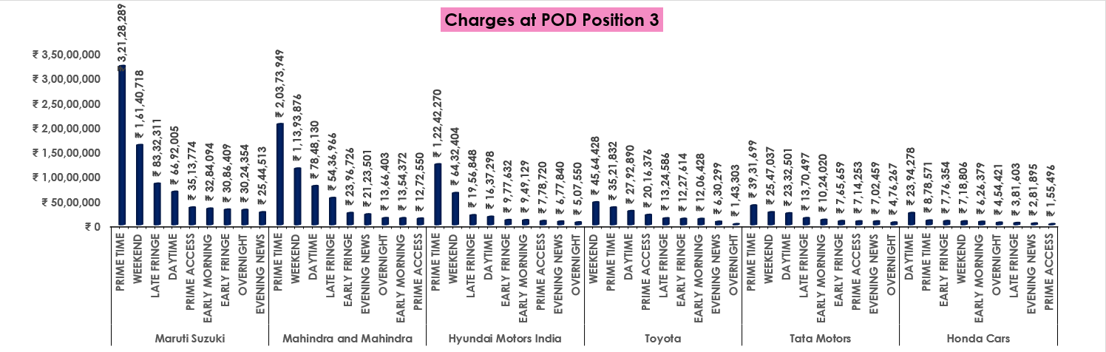
Analysis of POD Position 3
For POD Position Three, companies are charging nearly 25% less than Primetime of POD One. But more than POD Position 2nd.
In this chart also companies are charging more for prime time respective to other time zones.
The interesting thing is this, companies like to play ads in 3rd position over 2nd. It might be because it might have a small margin of charges in 2nd and 3rd POD

Slide 9
Question 2 What is the share of various brands in TV airings and how has it changed from Q1 to Q4 in 2021?
➢ Among all the quarters from quarter 1 to quarter 2
Suzuki has the maximum spending on ads which is in quarter no 1
➢ Maruti Suzuki has spent 54 Cr in the year 2021 and it is highest in 2021
➢ After Maruti Suzuki there are several brands that have spent the highest money as shown in the Graphical representation.

Slide 10
Analysis of the share of various brands

Slide 11
Problem 3. Conduct a competitive analysis of the brands and define their advertisement strategies and how they differ across the brands.
For that, I have analyzed the spending of brands with respective different features like month-wise, Position wise, etc., and come up with some insights.
➢ In a month-wise analysis of brands, I come up with that brand prefers January, February, March, and October for more advertisements in terms of money also and the number of advertisements also.
➢ Brands prefers cable network for advertisement over a broadcast network.
➢ Brands always try to play ads on POD Position 1st or 3rd mostly.
➢ Nearby 80 to 90% of brands make advertisements of 30 seconds and nearly 8% of brands prefer a 15-sec time frame for ads.
➢ Respective available data, brands like to run ads at the time of S-17401 show mostly, and then s-17261 show.

Slide 12
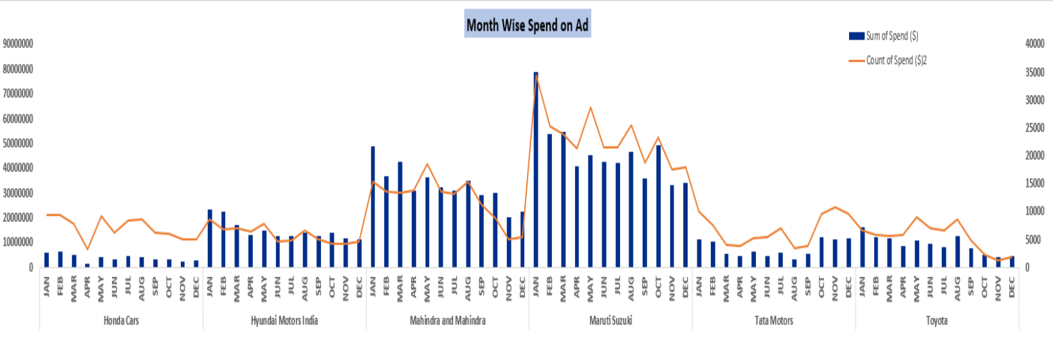
Advertisement strategy of different brands

Slide 13
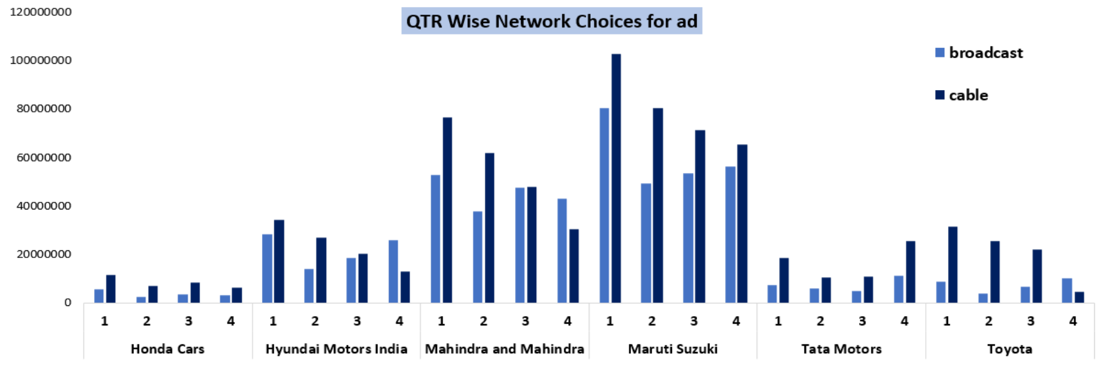
Quarter Wise Network Choices For AD

Slide 14
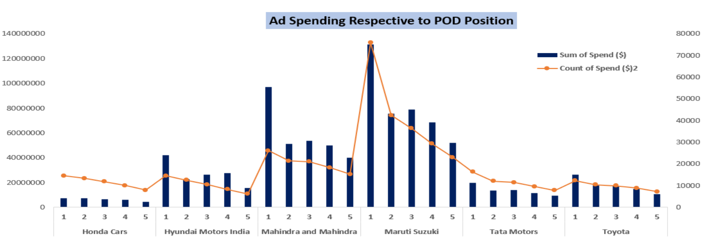
Companies spending respectively to pod position

Slide 15
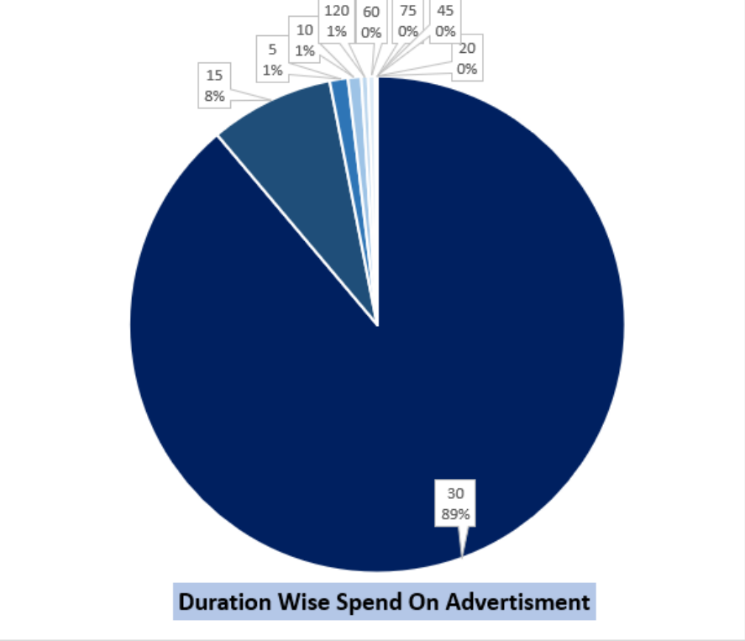
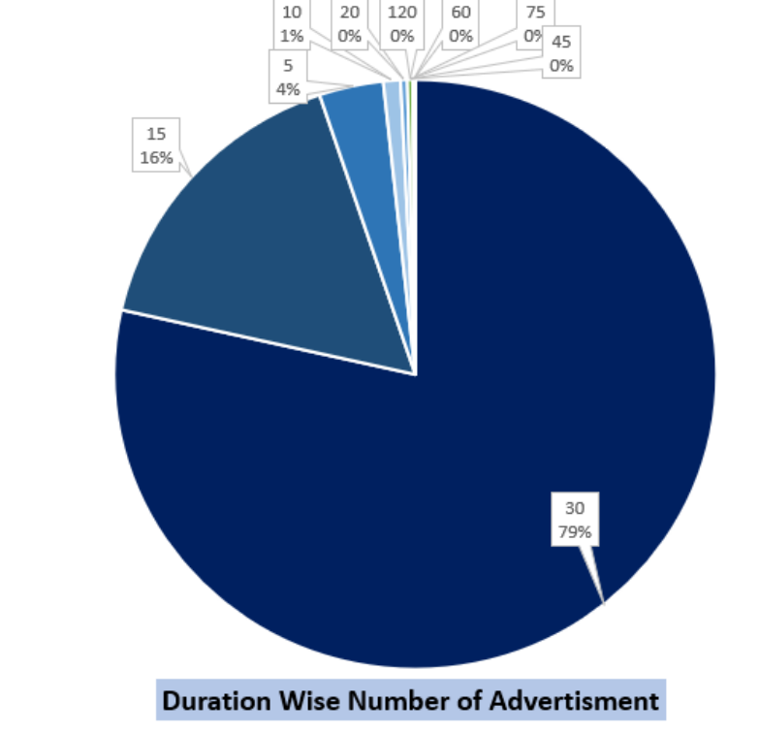
duration wise spend on the advertisement 89% of the companies prefer the 30-second time advertisement and after that 15-second advertisement is preferable

Slide 16
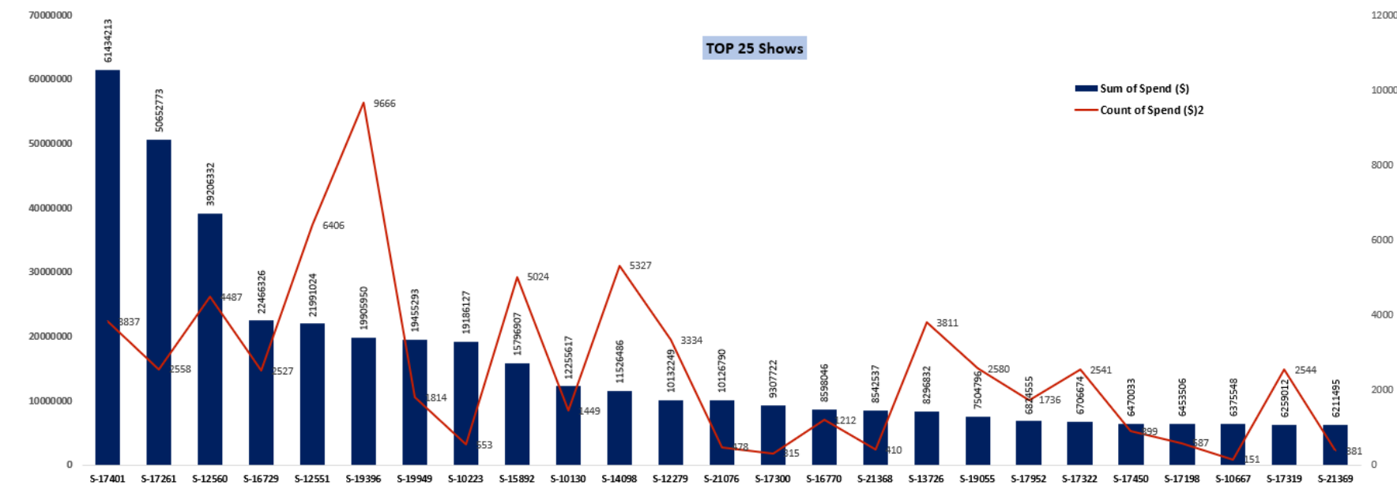
These are the top 25 shows in which ads have there high revenue and these are the best time to prefer the advertisement

Slide 17
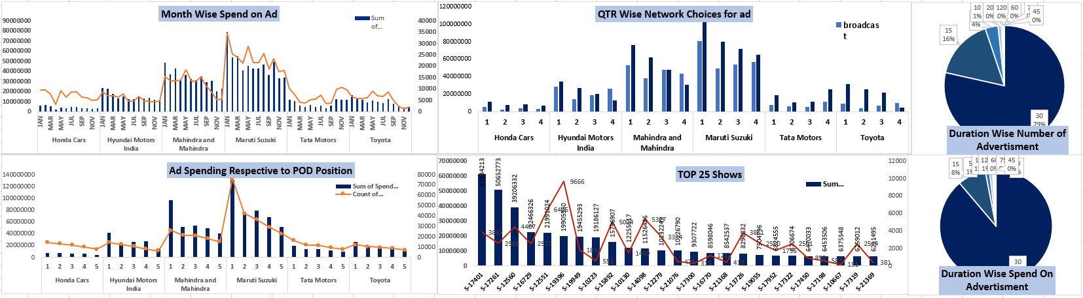
Conclusion This is the competitive analysis of the brands and their advertisement strategies and how they differ across the brands.

Slide 18
Problem 4. Mahindra and Mahindra want to run a digital ad campaign to complement its existing TV ads in Q1 of 2022. Based on the data from 2021, suggest a media plan to the CMO of Mahindra and Mahindra. Which audience should they target? *Assume XYZ Ads has the ad viewership data and TV viewership for the people in India. P.S. Brownie points for any additional actionable insights you can draw from the dataset.
I have analyzed the previous year’s data for M&M and last year’s M&M prefer
i. POD position 1st
ii. The time frame of ads was Prime Time and weekends
iii. Ad time was 30 sec and 60 sec both
In data, profit data is not provided so I can`t assume that these are good for them or not. But, I think this is a good strategy for this year also because if talk about the position of Ads it should be between the first three so it is after this time frame should be 30 sec I feel because lengthy things people do not attract the attention to people thing should be short and crisp so 30sec id ideal time frame and time frame is should be a prime time where people engaged in the program so we can reach to a number of peoples and about the weekend people try to spend weekend time with family mostly and watch things at home so this also good option.

Slide 19
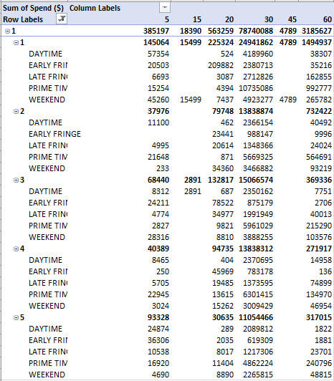
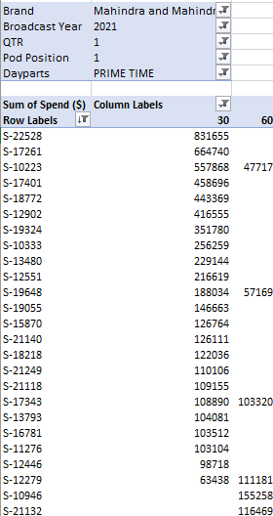

Slide 20
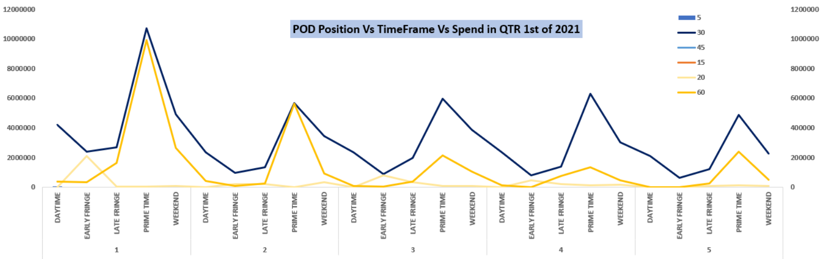
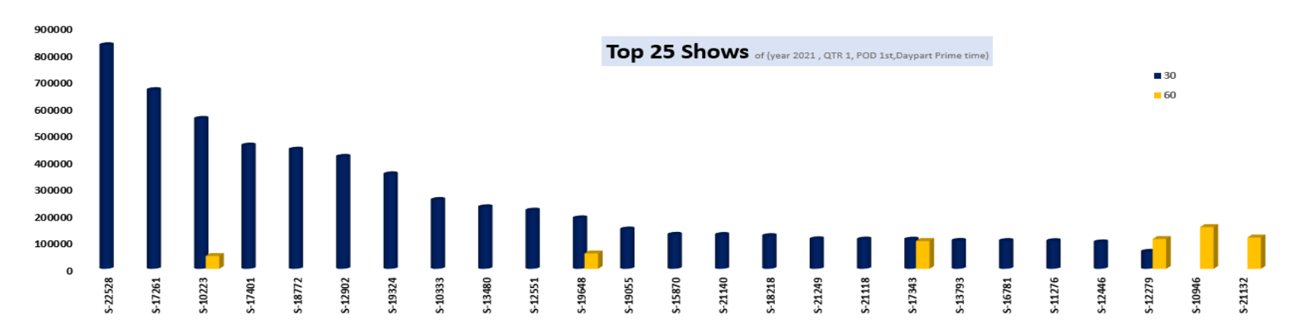

Slide 21
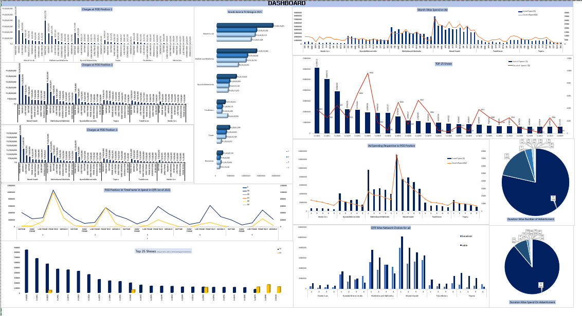

Slide 22
Insights and Conclusion
After completing the case study and analyzing all the data, I have drawn some insights from the study.
Pod position is the sequence that the advertisement runs.
The company Maruti Suzuki telecasts the advertisements almost all-day parts.
The company Maruti Suzuki is the highest company to spend money in a pod position.
The share value is higher in Quarter 1 and lower in Quarter 4.
The company Mahindra should telecast their advertisements in almost all the Prime-time pod position parts and the duration of the time of advertisement is 30 seconds so that it will be greatly helpful to grow the Mahindra company in the next financial year 2022.

Slide 23
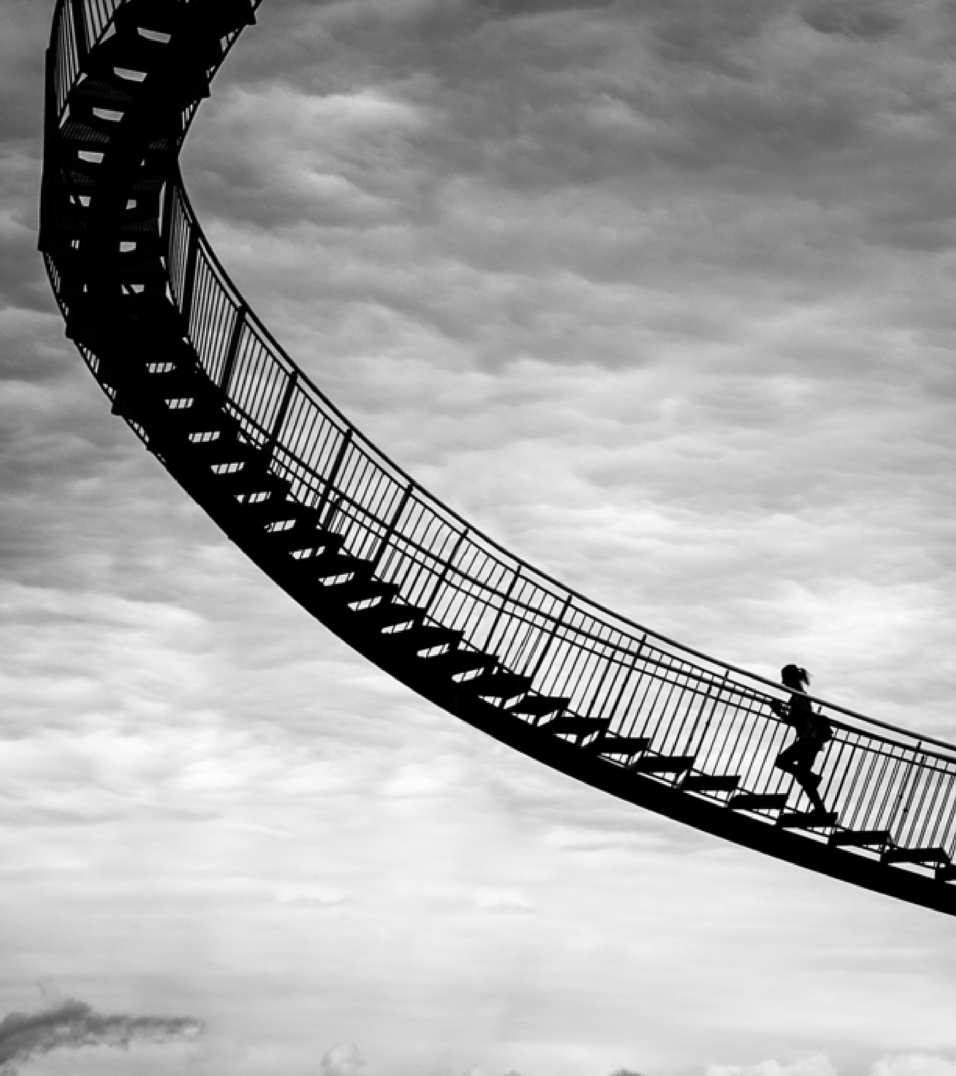
Thank you
Ayush Saxena
ayushsaxenamasai@gmail.com
Here I'm attaching the link of the spreadsheet:-
https://docs.google.com/spreadsheets/d/1idF84Tj9P5juy5tVX8zb66iICEOb0M-H/edit?usp=sharing&ouid=112242556178831629185&rtpof=true&sd=true

